Slide 1



Slide 2

Last lecture reminder
We learned about:
Different types of errors in software programs
Introduction to error handling and how we should apply it
Error handling in Python:
try - except block
The finally keyword
Create and throw custom exceptions
Lambda functions in Python

Slide 3
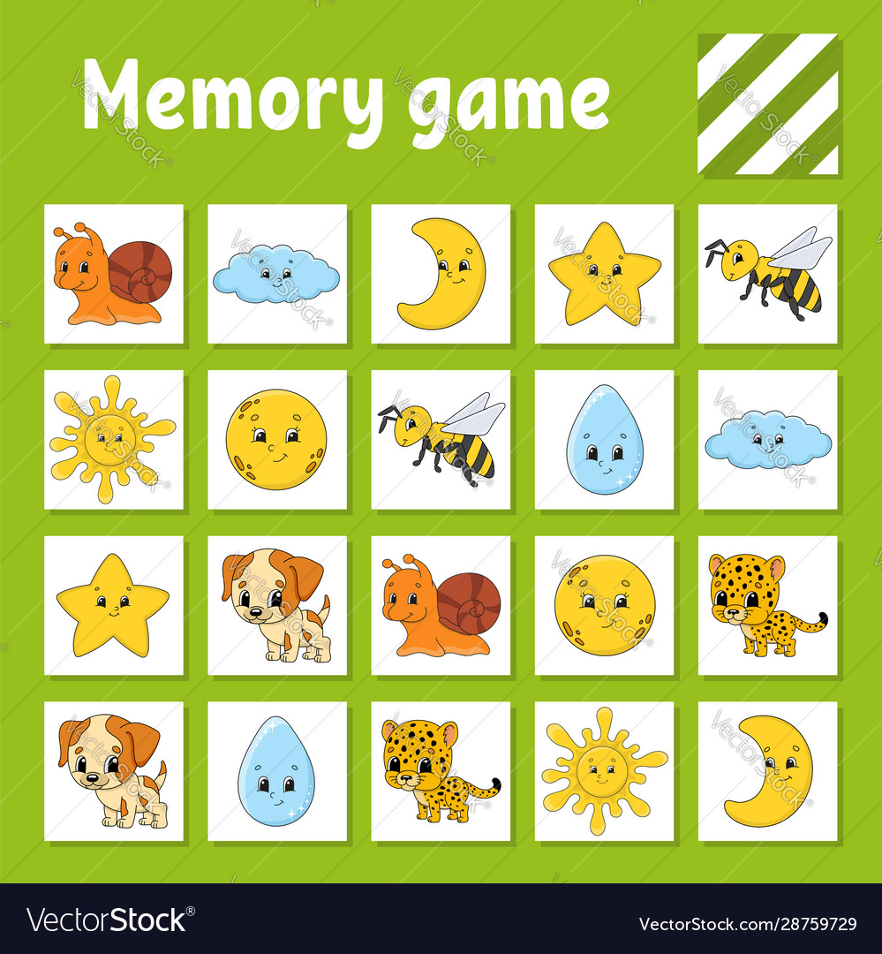
Building a Python Memory Game

Slide 4
Class Coding - Memory Game
Game Instructions:
We want to build a memory game by using Python basic syntax and functions.
The game rules are simple:
Every time a new game starts, our program will prepare a deck of cards with pairs shuffled randomly. The deck consists of pairs of 'A', 'B', 'C', 'D', 'E', 'F' cards, shuffled in a random order.
The player is not shown the actual cards, but rather placeholders for the cards.
The aim of the game is for the player to guess pairs of identical cards. Player initiates a guess by entering the index of a card (between 0 - 11) they want to uncover.
After the first guess, the chosen card’s identity is revealed and the player needs to make a second guess, picking another card index they believe holds the matching card.

Slide 5
Class Coding - Memory Game
Game Instructions:
If the two chosen cards are a match, they remain visible and the player is notified that they've found a pair.
If the two chosen cards are not a match, both cards return to their hidden state, and the player is notified that the pair was not found. The player will then need to initiate another pair guess by choosing new two cards.
The player continues guessing pairs until all pairs have been correctly found.
There's also a restart game option, represented by 'R'. When the player input 'R', the current game is restarted.
The game ends when all pairs are correctly guessed by the player, and the player is congratulated for winning the game.
The player can opt to play the game again or quit the game after the end of each game round.

Slide 6
Building a Python Memory Game
Before we start with the coding let’s first think about the logical flows we want to create here:
Init the game (Shuffle the cards randomly for every game initiation)
Give the user the ability to select two different cards each turn
Card matching check algorithm
If the cards are matched we want to notify the user about it and remove them from the board (making them unavailable to be chosen again)
If the cards are not matched we should allow the user to select them again

Slide 7
Class Coding - Memory Game

